Slide 1
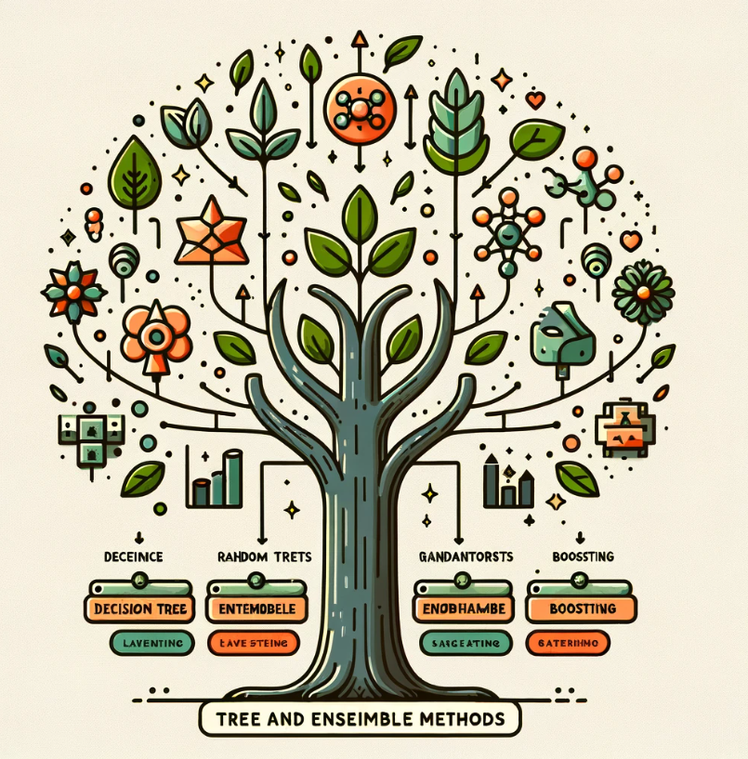
Section 4
CSE/STAT 416
Note: the image on left is DALL-E generated (look at mistakes)

Slide 2
Announcements
HW3 will be released tomorrow
Monday 4/29 by 11:59 PM: Learning Reflection Week 4

Slide 3
Agenda
Naive Bayes Recap
Decision Trees Recap
Ensemble Methods Recap
Random Forests Recap
Bagging
AdaBoost Recap
Boosting
Ed Notebook Demo

Slide 4
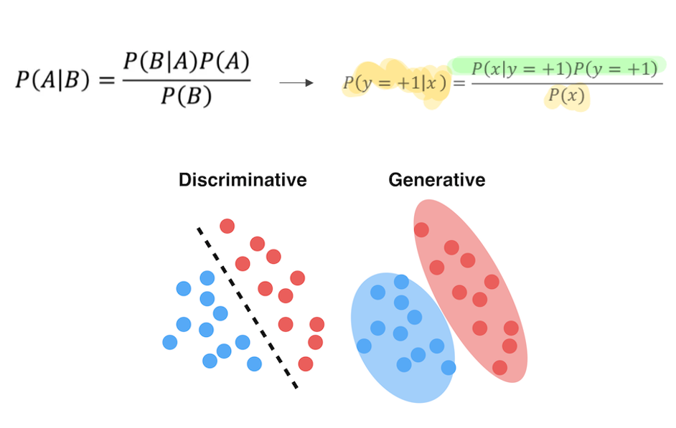

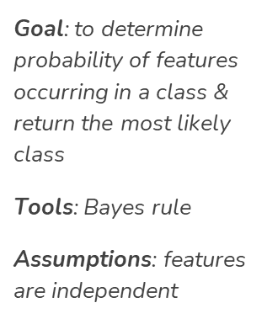
Naive Bayes
Notes:
Ignore denominator because it normalizes the data and is just extra math
X = “This is a sentence”
P(X|y=+1) = P(This|y=+1)*P(is|y=+1)*P(a|y=+1)*P(sentence|y=+1)
What happens if a probability is 0?
Log
Laplacian smoothing
Need labeled training data
Generative- learn the distribution of the data itself

Slide 5
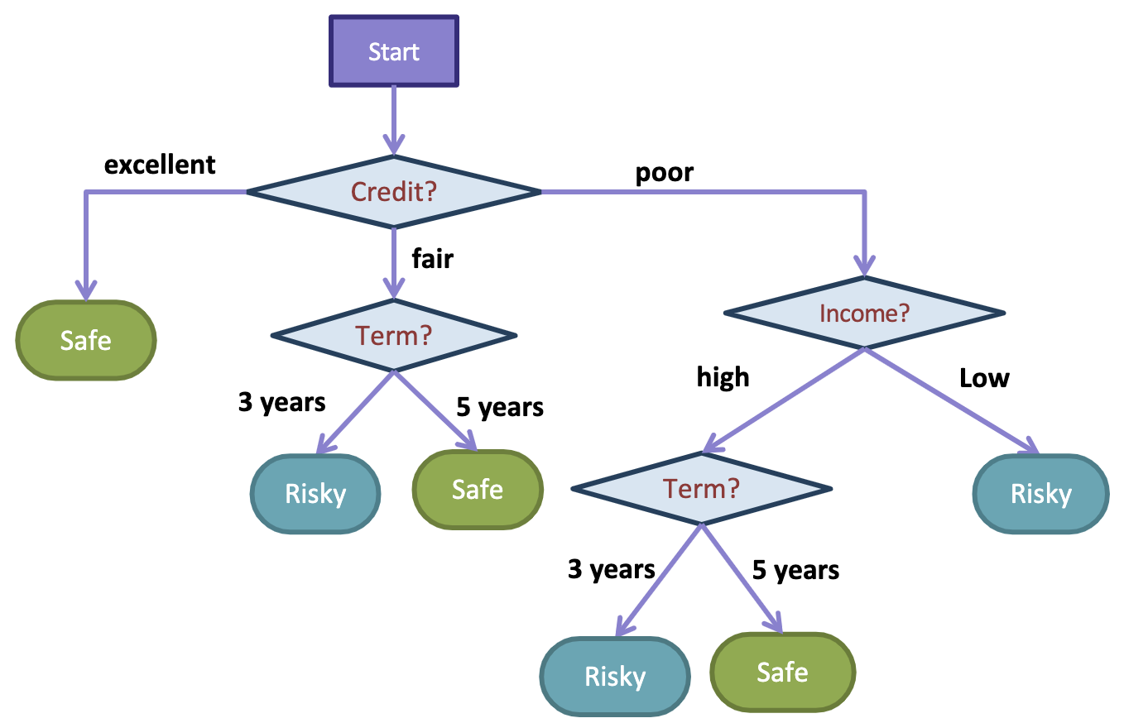
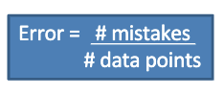
Decision Tree
Root Node
Basically a series of nested questions
Can be used for both classification and regression cases
Trained by selecting splits with lowest classification error
Branch Node
Leaf Node
Notes:
If we use the decision tree algorithm to learn a decision tree from this dataset, we choose a feature to be split for the root node by taking the split that results in the lowest classification error.
For example, can be used to detect if something is spam or not spam, or if something safe or not risky. It can also solve the regression problem and predict what a house price is based on features like square footage, number of bedrooms, and number of bathrooms.
The way it is trained is by starting at the root node and selecting splits with the lowest classification error and continuing
In this way they are trained in a greedy and recursive method
So for example the way this tree was trained that predicts whether or not a person is risky or safe for a loan is by starting at the root node and splitting on each feature and calculating the classification error. Then the split with the lowest error is selected and the process continues for these internal/branch nodes.
Avoid overfitting by only growing to a certain depth that you fix (hyperparameter)

Slide 6
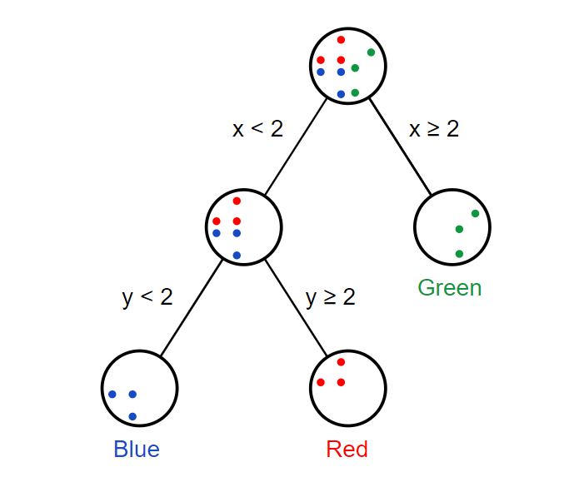
Decision Trees
What kind of questions do we put at the nodes
With categorical features
Split node for each possible value of category
E.g. Major -> CSE, STATS, BIO
Numerical feature
Pick a split value and compare

Slide 7
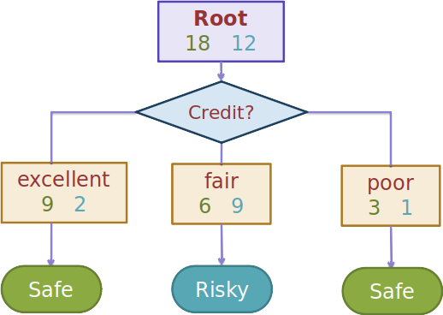
Decision Trees
Interpretable (When not too deep)
Easy to train
Prone to overfitting (when too deep)
(Low Bias, High Variance) when deep
(High Bias, Low Variance) when shallow
Conclusion:
Cannot satisfy all needs
Not the best performing model

Slide 8
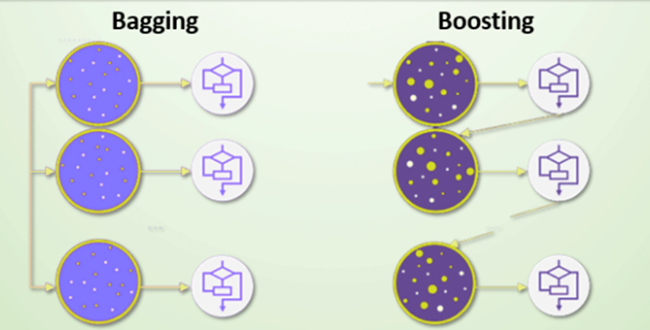
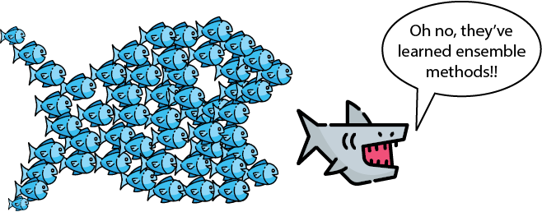
Ensemble Methods
A way to combine weaker models into a more powerful model!
Commonly done with trees through:
Random Forest (Bagging)
AdaBoost (Boosting)
Notes:
In summary, bagging consists of constructing a few models in a random way and joining them together
Boosting, on the other hand, consists of building these models in a smarter way by picking each model strategically to focus on the previous models’ mistakes.

Slide 9
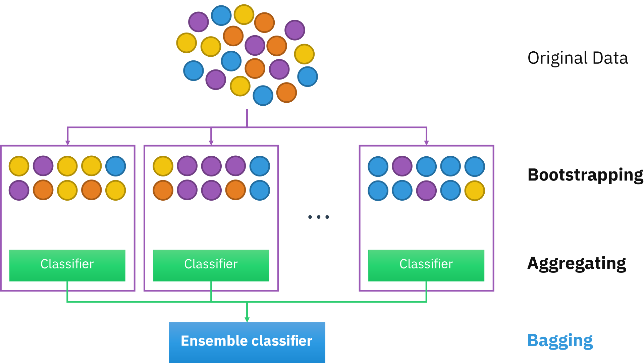
Random Forest (Bagging)
Idea: combination with many high-variance(overfit) trees will result in a low variance, low bias classifier
collection of trees, each tree has a vote for prediction and then predicts majority vote of all trees
employs bootstrapping
parallel learning
high accuracy and efficiency

Slide 10
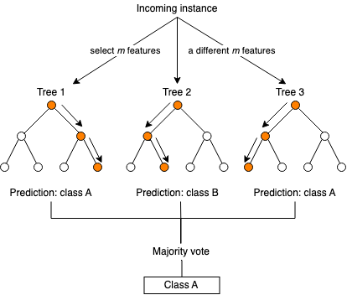
Random Forests Recap
Uses overfitting to our advantage
Average many high variance (overfit) models to get low bias and low variance model
Good “out of the box” model
Notes:
Each of the models in the ensemble can easily be trained in parallel (i.e. in any order).
Good “out of the box” model
More trees is always better
Tends to require less hyperparameter tuning
Good model to try first before exploring other models
Works for regression too

Slide 11
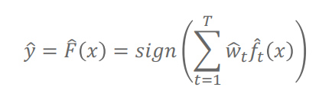
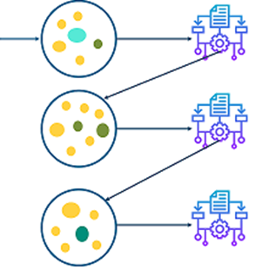
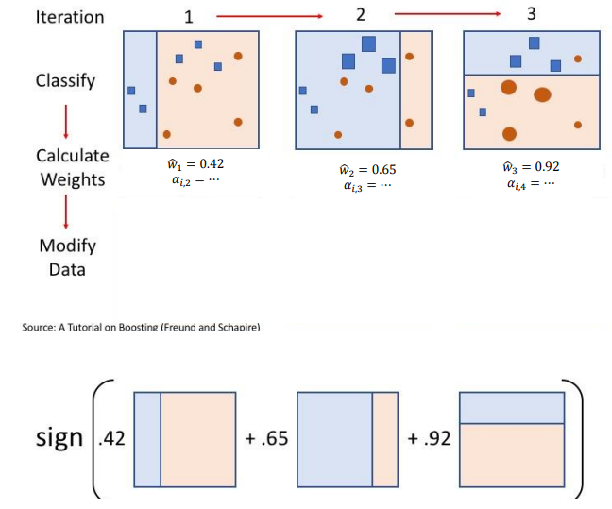
AdaBoost (Boosting)
Idea: Train many weak classifiers (decision stumps) sequentially and assign weight to each classifier and use weighted majority vote to get the final prediction.
Notes:
Random forests are a parallel extension to basic classification (training 1000s of models independently)
AdaBoost is the sequential extension.
Here, the next model depends on the performance of the previous models
Adaptively each new model corrects the mistakes of the previous ones.
A way of combining “Weak Learners”

Slide 12
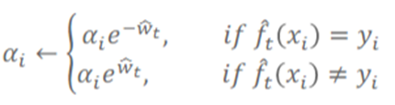

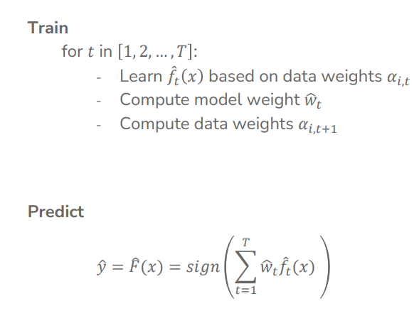

AdaBoost algorithm overview
Important concepts
Example weights (a_{i})
Each example starts with weight=1 and gets updated each iteration
Model weights (w_{t})
Each model gets a weight based on its performance
high weight for models that are accurate
low weight for models that are not.
Final classifier is a weighted combination of all models

Slide 13
AdaBoost continued
Usually we use decision stumps - decision trees with depth 1
We need “weak” learners, a classifier with very low accuracy
Compared to decision trees
Reduce overfitting
Increases validation accuracy
Number of iterations?
Use hyperparameter tuning

Slide 14
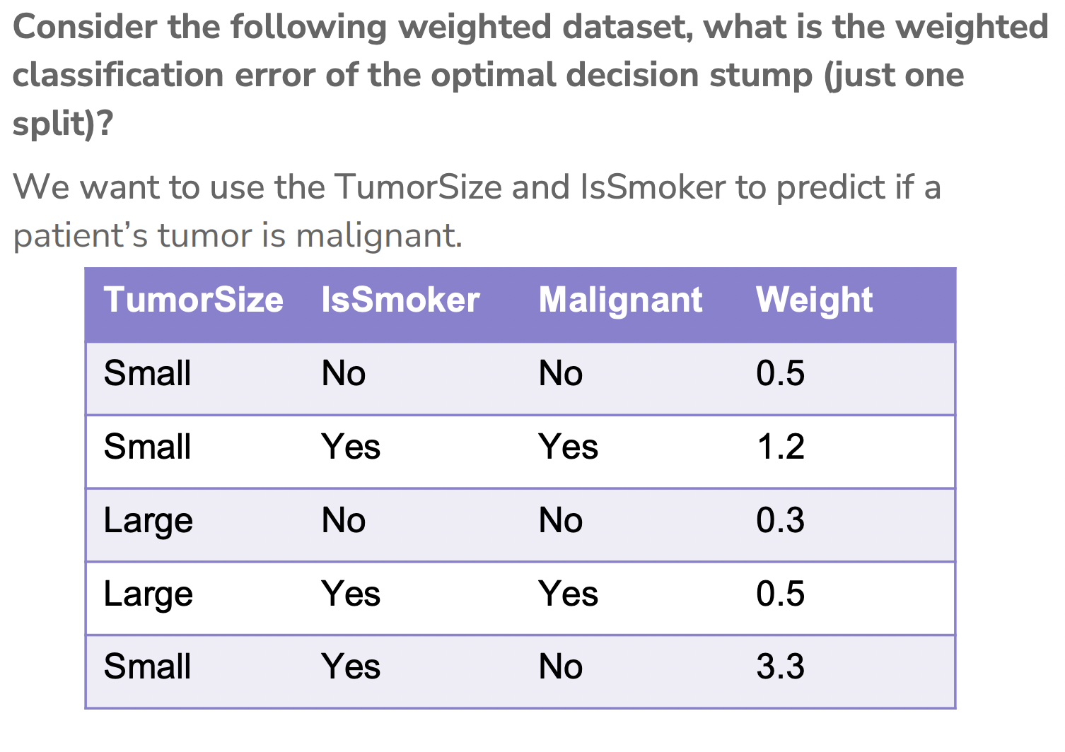
AdaBoost Example

Slide 15
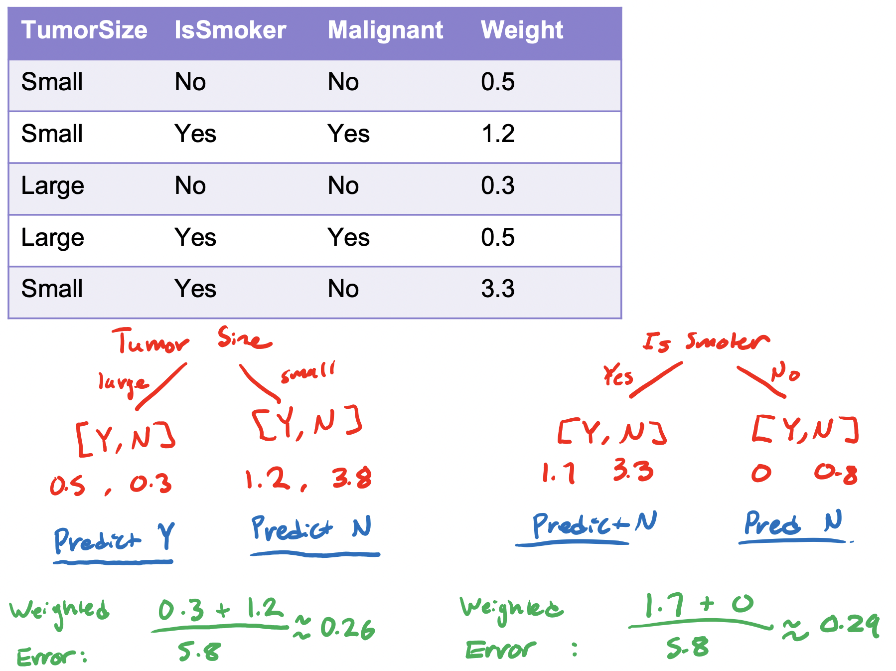
AdaBoost Example

Slide 16
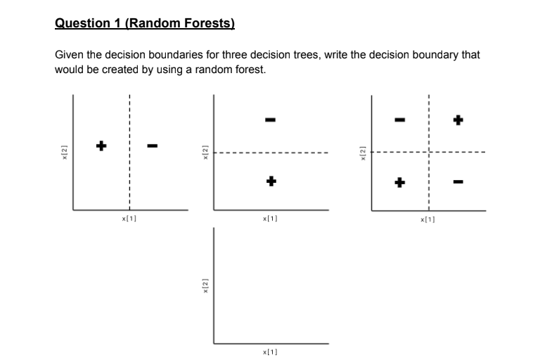
Concept Check
-
+

Slide 17
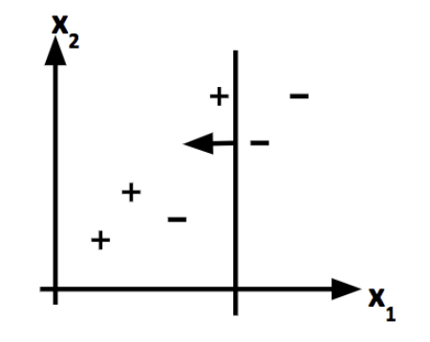
Concept Check
Predicts +1
Predicts -1
Which points in the figure would increase in weight as a result of incorporating the first decision stump using AdaBoost?
What would the next decision stump look like?
Notes:
Notice how initially all points have equal weight

Slide 18
Concept Check
Which of the following is a true statement about random forests?
a) Random forests always outperform single decision trees on small datasets.
b) Random forests are less prone to overfitting than single decision trees.
c) Random forests can only handle categorical data.
d) Random forests are a type of unsupervised learning algorithm.
Notes:
Not necessarily true because a single decision tree can be trained on a particular data set and have zero classification error due to being a really tall tree, and the same dataset could be
True because you are averaging a bunch of high variance models to get a low variance model that is less prone to overfitting. Can Random forests still overfit? Yes, they can.
d. False. Trained on labeled training data.

Slide 19
Ed Notebook Demo!

